Slide 1
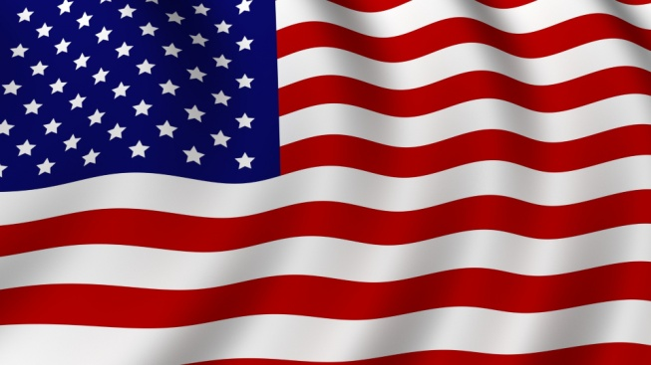
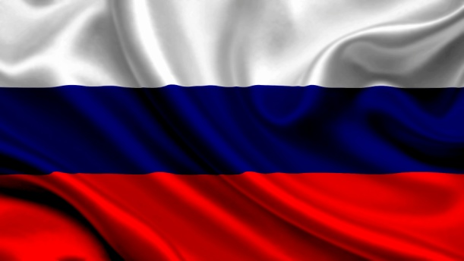
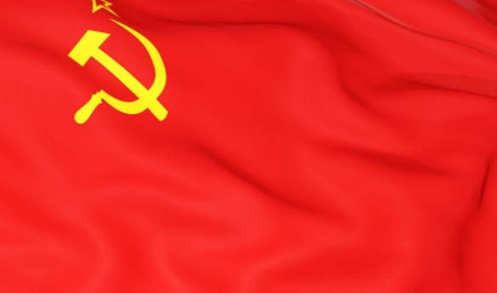
School uniform form in Russia and America
Dasha Kuzmina
Dasha Timohina
9 form

Slide 2
«The emergence of school uniforms»
20 years ago, according to the Law of the Russian Federation number 3266 - 1 «On education» , adopted in 1992, was abolished the mandatory wearing of school uniforms in Russian schools.
Students have changed their brown and blue suits to casual wear. Increasingly, in the media and on internet forums began discussing the introduction of school uniforms.
This opinion was expressed by students, parents, school principals, journalists

Slide 3
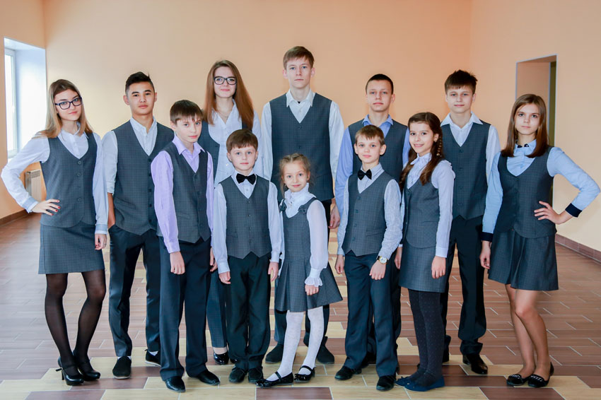
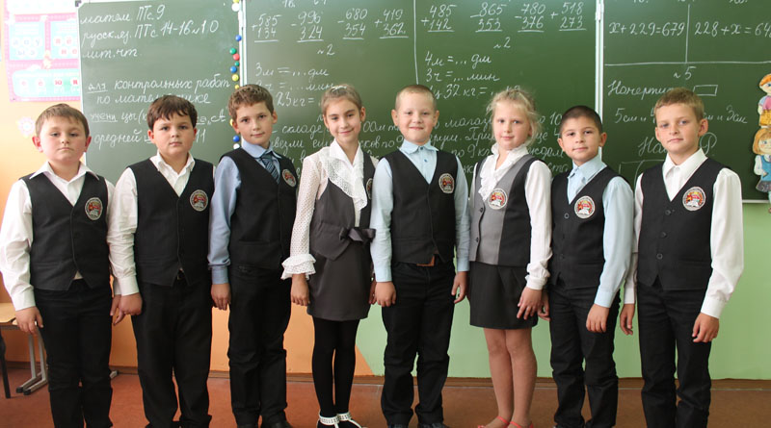
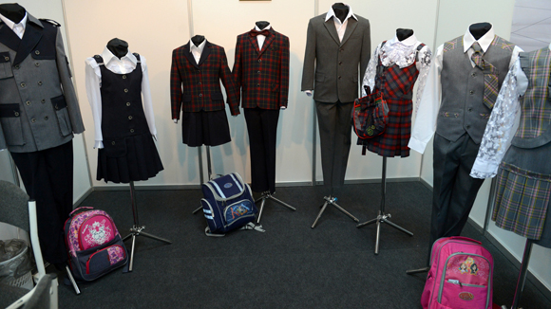
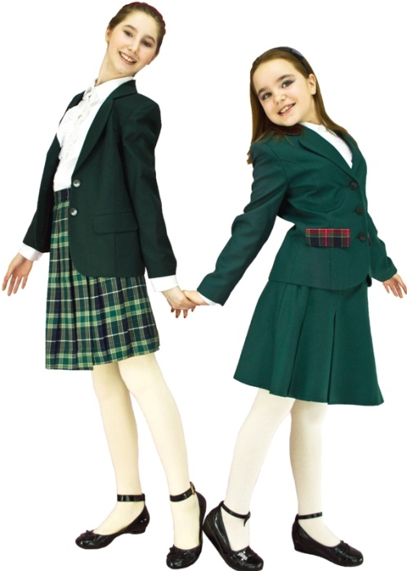

Slide 4
«School uniforms in the USSR » In 1918, the gymnasium form of pre-revolutionary Russia was abolished as part of the Unified Labor Soviet school. This failure on the form was one very important reason poverty. Children went to school wearing clothes parents could give them. The exception in 1930 was only a pioneering form-and that is completely unified form had only in such camps-giants as the "Artek" or in specialized camps where there were opportunities for centralized tailoring.

Slide 5
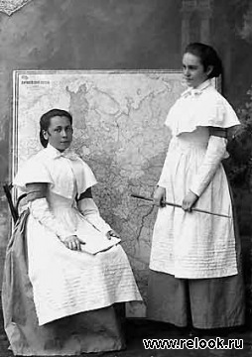
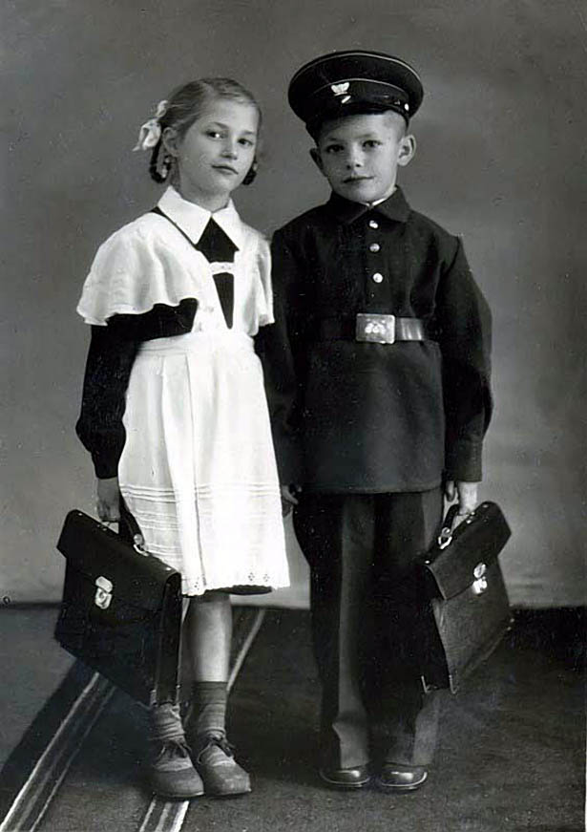
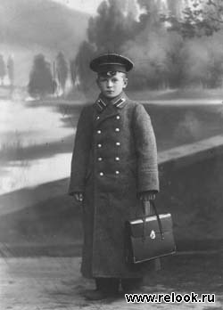
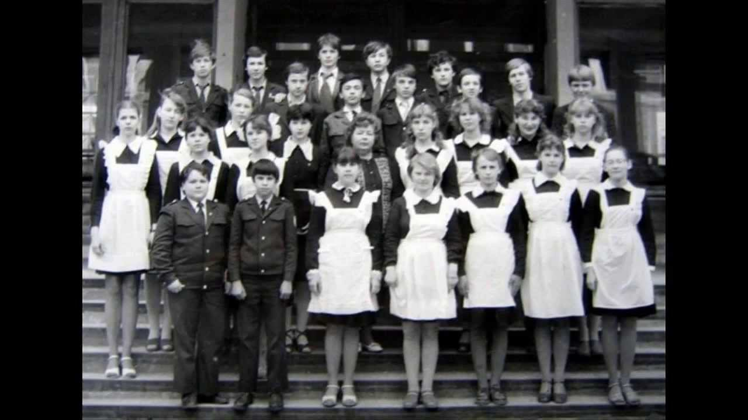

Slide 6
«School form in America» School uniforms distributed in America, mainly in private schools. And it contains the logo of the institution. In conventional public schools, not every school uniform. But there are certain rules of style of dress. And in different institutions have different rules. For example, the length of a mini skirt should be no shorter than the tips of the fingers, transparent clothing is prohibited. As a rule, students wear simple clothes

Slide 7
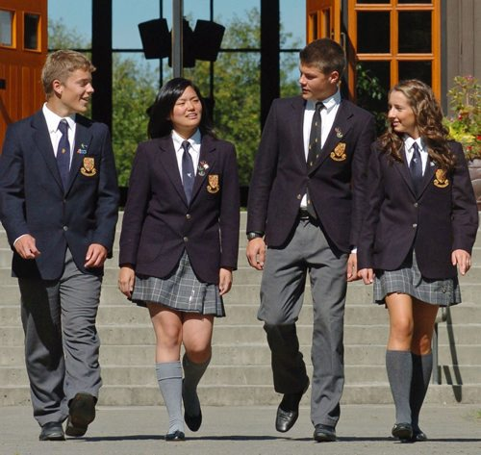
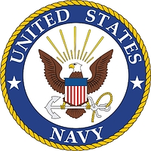

Slide 8
« School uniform in the Britain» Ninety - two percent of British schools are state schools.
That means they're free. The government pays - not the parents.
Eight percent of schools are independent.
And some of these schools have very traditional uniforms. These boys are from Eton - a very famous independent school

Slide 9
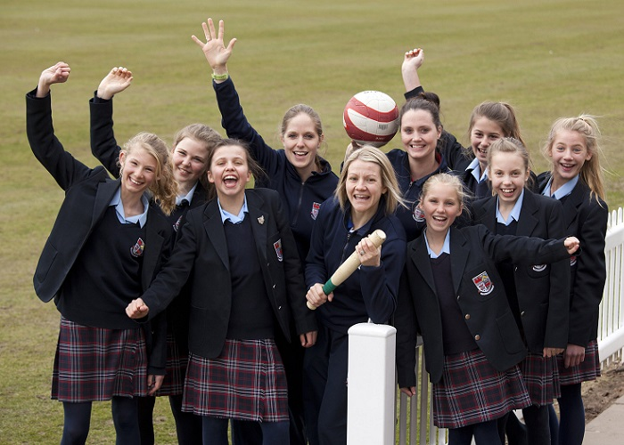
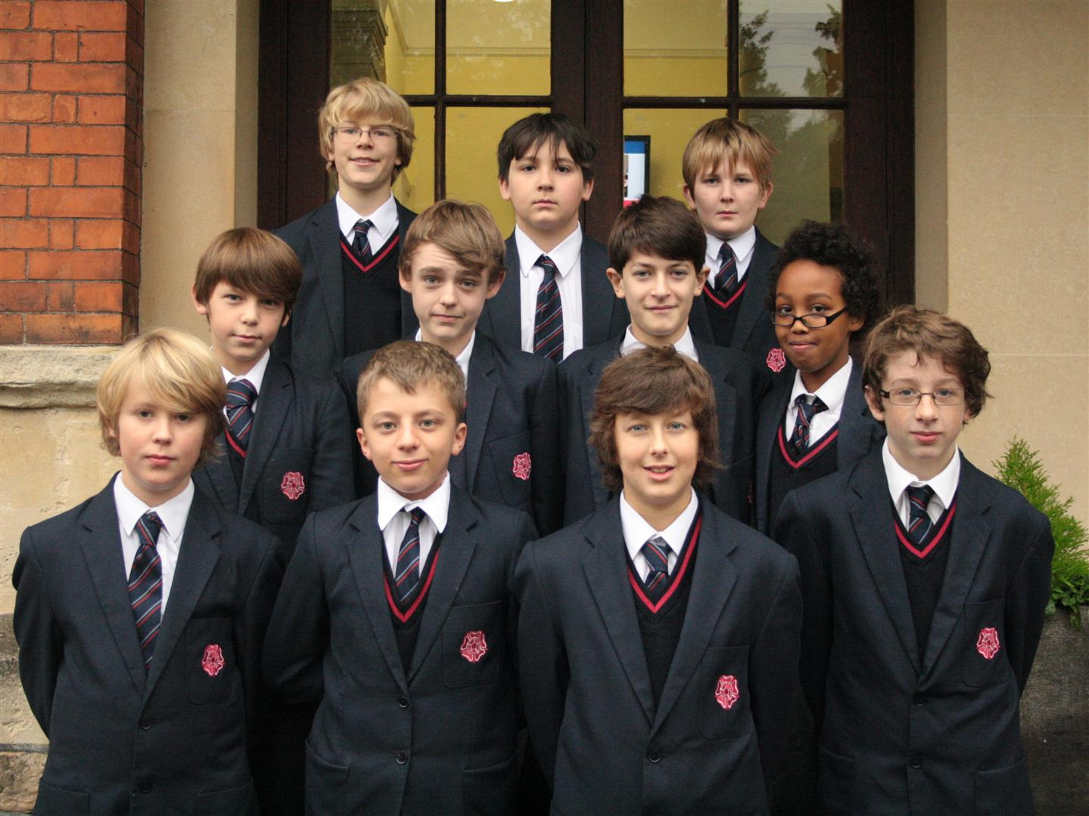

Slide 10
Thank you for your attention

