Slide 1
Project
Olga Rogozhnikova, Kseniya Kuraleva
Anna Shashkova
9 «В»

Slide 2
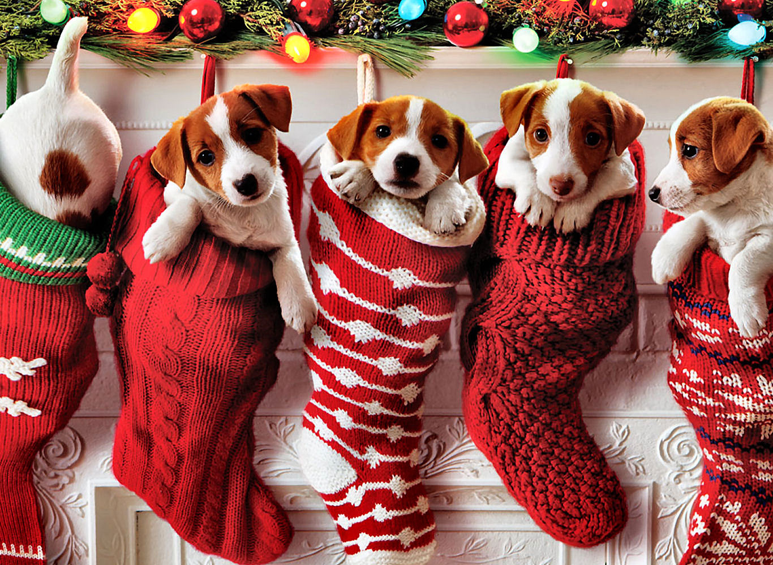
2018 the New year we wish You good luck and good exams.

Slide 3
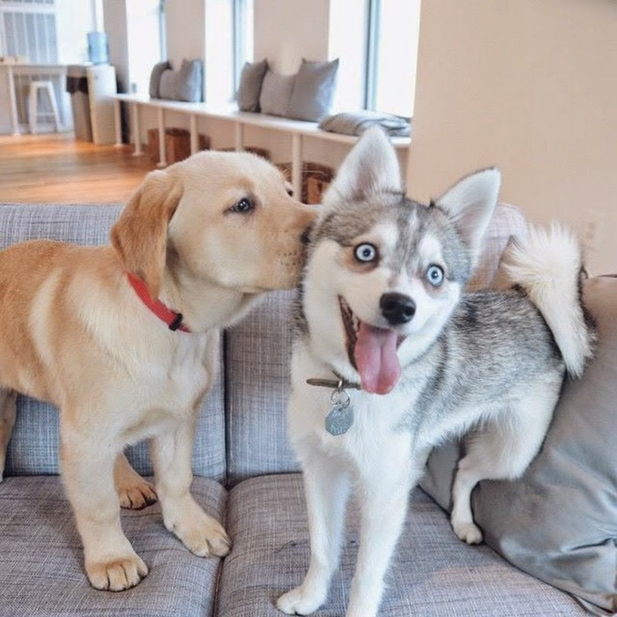
The dog is a faithful friend

Slide 4
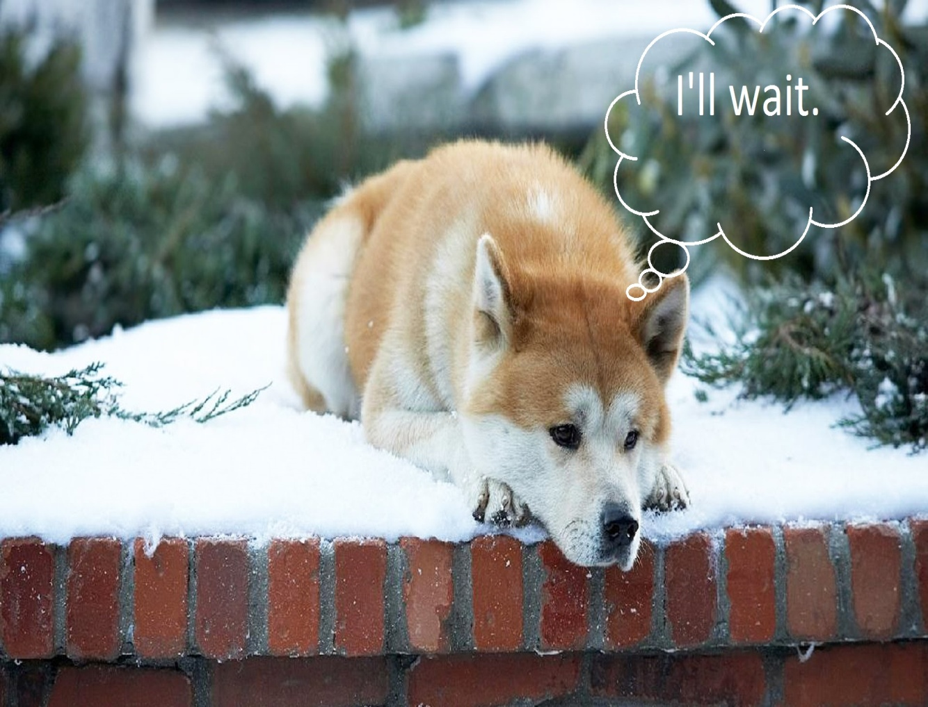
Dog and man
Dogs are very loyal to people. There are many legends about dogs and one of them is about Hachiko.

Slide 5
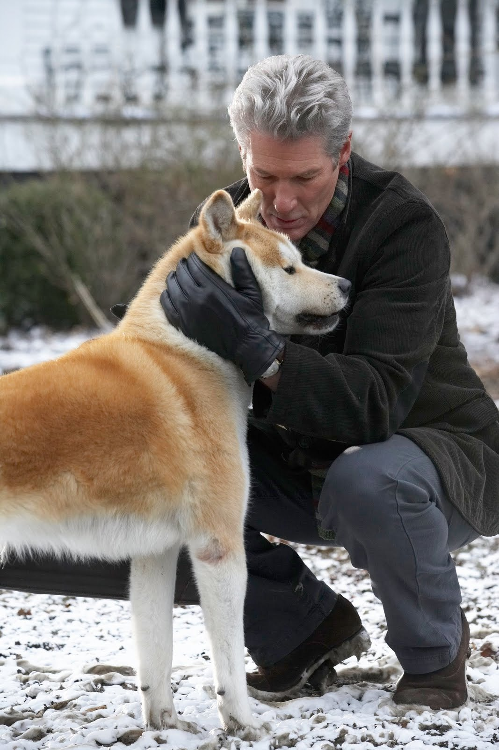
In 1925, Professor Ueno, Hidesaburo died of a heart attack. At that time Hachiko was eighteen years old. Despite this, he still continued to wait for his master. As before, the faithful dog came every day to the station until late evening. Relatives tried to identify Hachiko with friends, but, alas, once again, the dog continued to walk to the station and wait for the host.

Slide 6
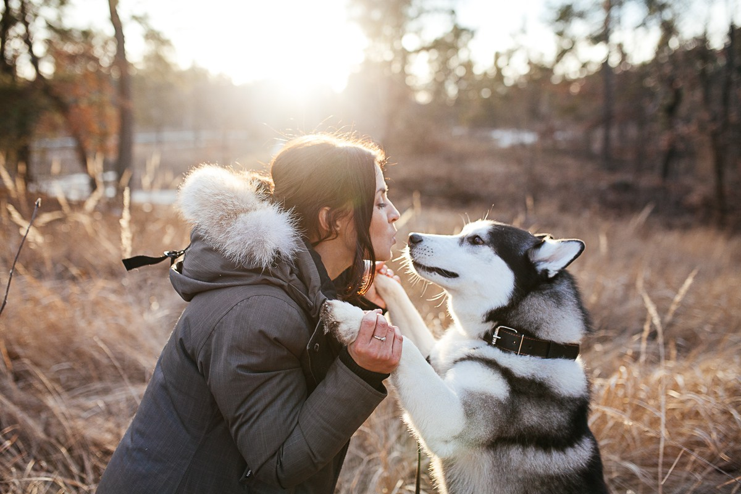
Dogs love their owners. They are waiting and bored near the threshold even when the owner drove up to the house, the dog always finds the sound of his car and, with faithful eyes and wagging tail, he meets his master.

Slide 7
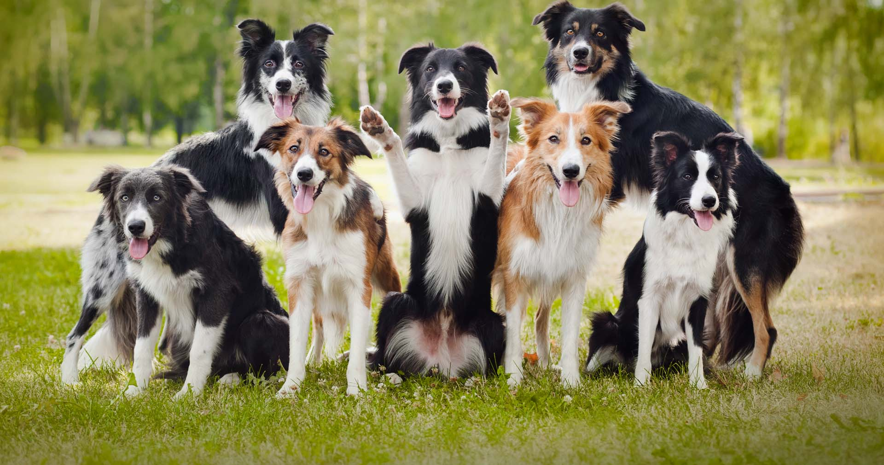
Dogs are not people. They do not betray, do not leave and always come back.

