Slide 1
Five extreme entertainment.
Prepared by: Anna Shashkova,
Stepan Schepkin,Valera Shilova.

Slide 2
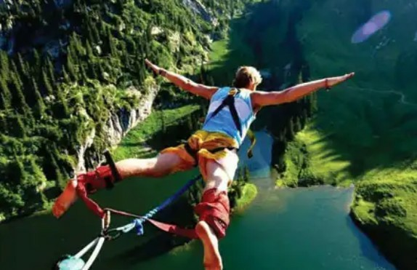
Bungee jumping №5

Slide 3
If you want to feel what adrenaline drive is, go to bungee jumping. Jump down from unreal height. The person is held only by an elastic cable, which will spring to a complete stop. Thus, even after a fall, you will continue to jump helplessly in the air for a while. Objects for jumping are selected not only towers and high-rise buildings, but also driving means, for example, a helicopter or a balloon.

Slide 4
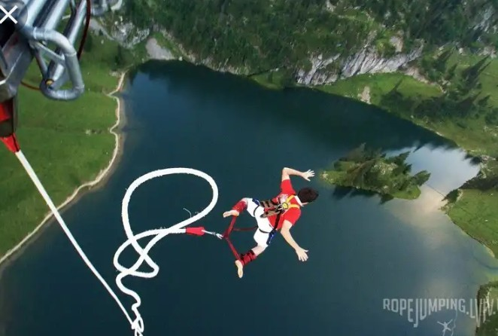
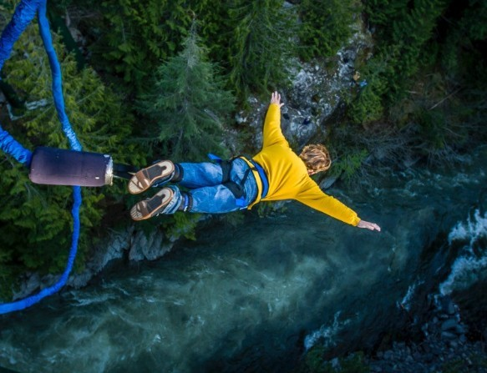

Slide 5
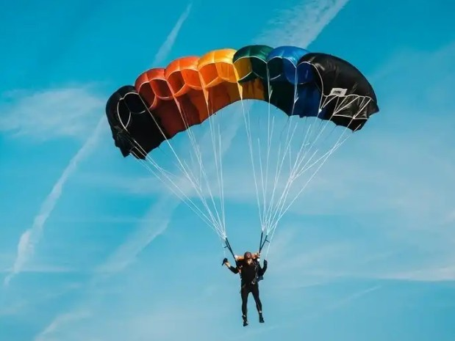
Skydiving №4

Slide 6
This sport involves jumping from a flying vehicle - an airplane or a helicopter. Some time, before the parachute opens, you will be in free flight, and then smoothly, within a few minutes, sink to the ground.
A complete set of necessary equipment, including:
container,main domereserve canopyhelmet,altimeter,other protective equipmentcan be about $ 5,000. The cost of a jump varies depending on the country and the company providing the jumps. For beginners offered tandem flights, as well as training in special schools.

Slide 7
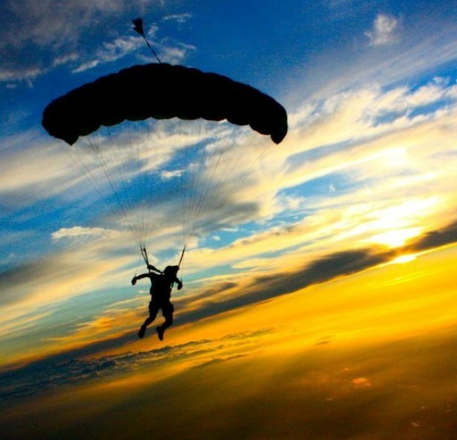
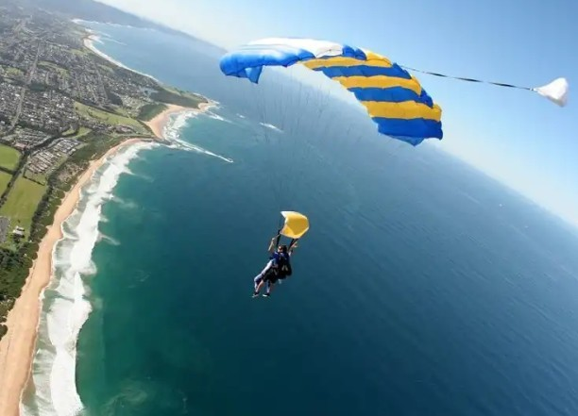

Slide 8
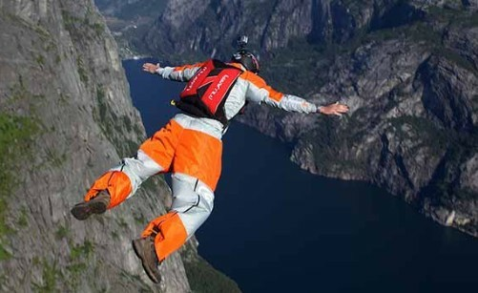
Base jumping №3

Slide 9
This type of entertainment is not only extremely dangerous, in some countries it is officially banned. To start, a platform is selected on a section of a cliff or building, located at about 600 meters height. From here the daredevils jump down, armed with parachutes. This height assumes that you have only a few seconds to open the parachute and avoid hitting the ground.

Slide 10
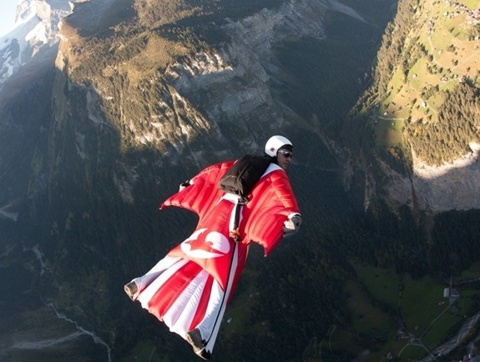
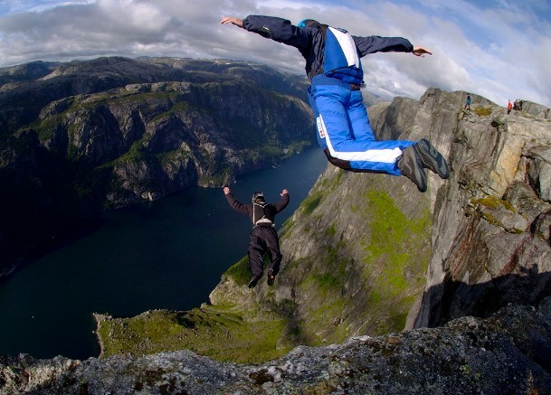

Slide 11
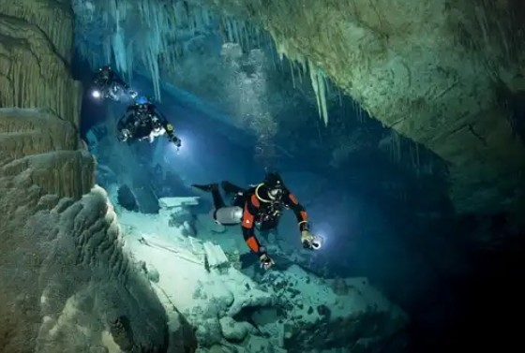
diving in underwater caves №2

Slide 12
This is the most dangerous form of scuba diving, and only a few dare to do it because of the high cost and the difficult level of training required. All standard equipment used by divers is simply useless. Since the problems that can be encountered when diving into caves are completely different:
failure to cover
hypothermia
all sorts of injuries.
If you decide to engage in this sport, get ready to spend about $ 9,000 on equipment, not to mention the cost of travel to the dive site and the dive itself.

Slide 13
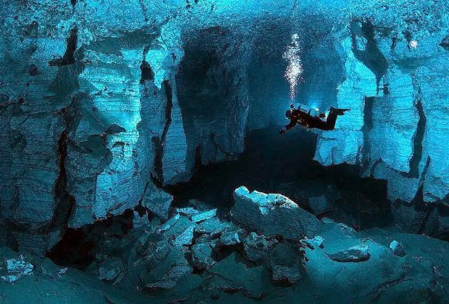
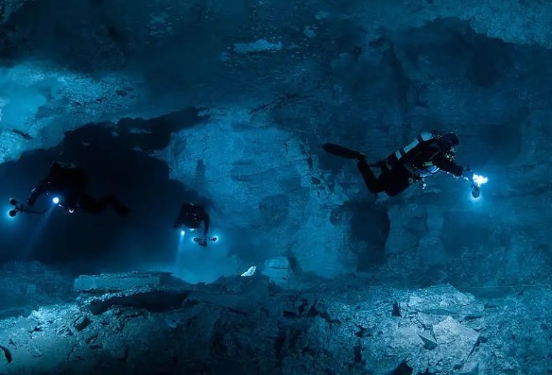

Slide 14
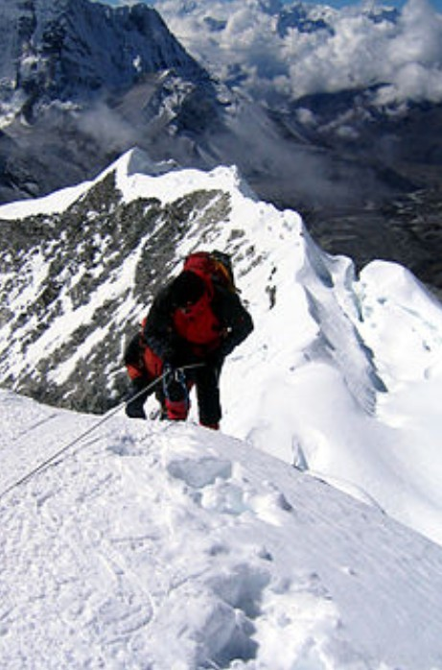
high altitude mountaineering №1

Slide 15
More than 50 years have passed since the conquest of Everest, and the number of brave souls who want to repeat the ascent does not decrease. The price you need to pay to enter the world's highest peaks can drive you crazy. For the expedition you need special equipment, without which the climber will not survive even for several hours.

Slide 16
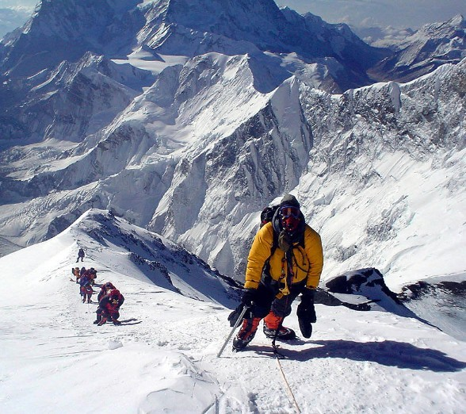
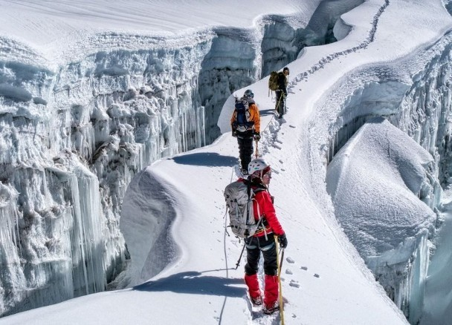

Slide 17
Thanks for attention.

