Slide 1
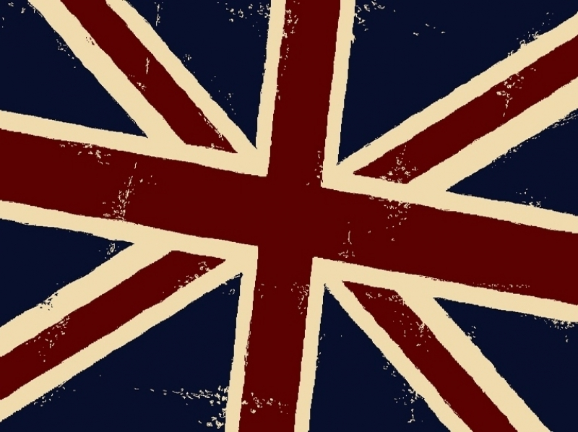


Music in great Britain
Gleb Chernov
1

Slide 2
List of Content
3. Origins of modern British music
4. 1920 – ragtime and jazz
5. 1930 – swing
7. 1940 – boogie-woogie
8. Mid-40’s “skiffle”
9. 1950 – Rock’n’Roll
10. 1960 – The Beatles
11. 1970 – Glam Rock and Punk
13. 1980 – hip-hop
14. 1990 – britpop and trip-hop
16. 2000 – music in Britain today: Alternative, Hardcore, Post-Hardcore
2

Slide 3
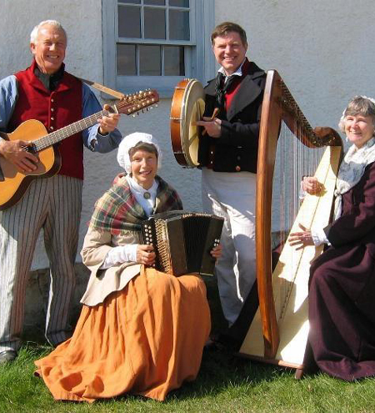
Origin
The origins of music in Britain lie in the songs sung and dance music played by ordinary people. Passed from village to village and handed down in the unwritten form from generation to generation.
3

Slide 4

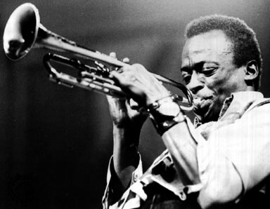
Music in Britain from 1920s to the Present Day
1920s
People listened to ragtime and jazz. These styles originated in the USA, but still were very popular in Great Britain.
Ragtime has lively and springy rhythms, and therefore it is ideal for dancing. Its name is believed to be a contraction of the term “ragged time,” which refers to its rhythmically broken up melodies.
4

Slide 5
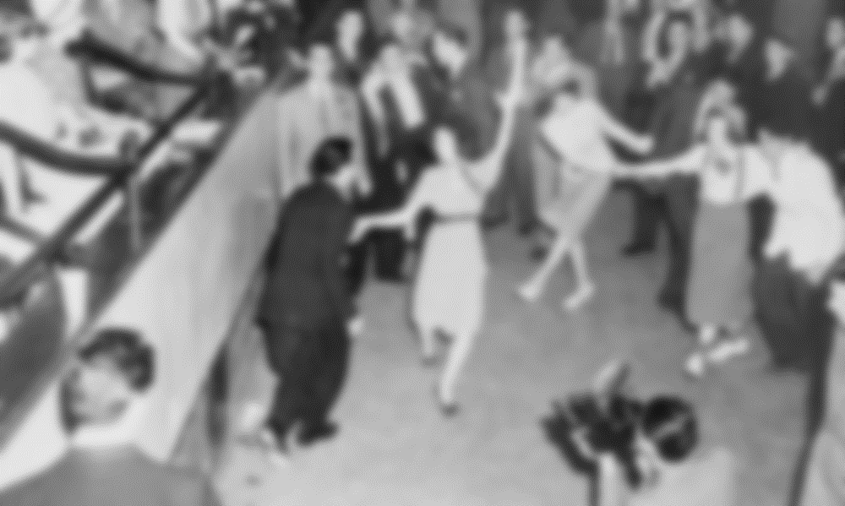
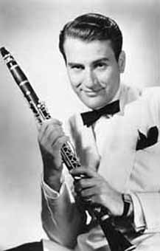
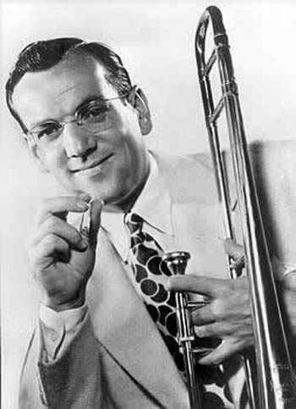
Artie Shaw
Glenn Miller
1930s
Swing became popular. Benny Goodman and his Orchestra were the 'King of the Swing', as were Glenn Miller and Artie Shaw.
5

Slide 6
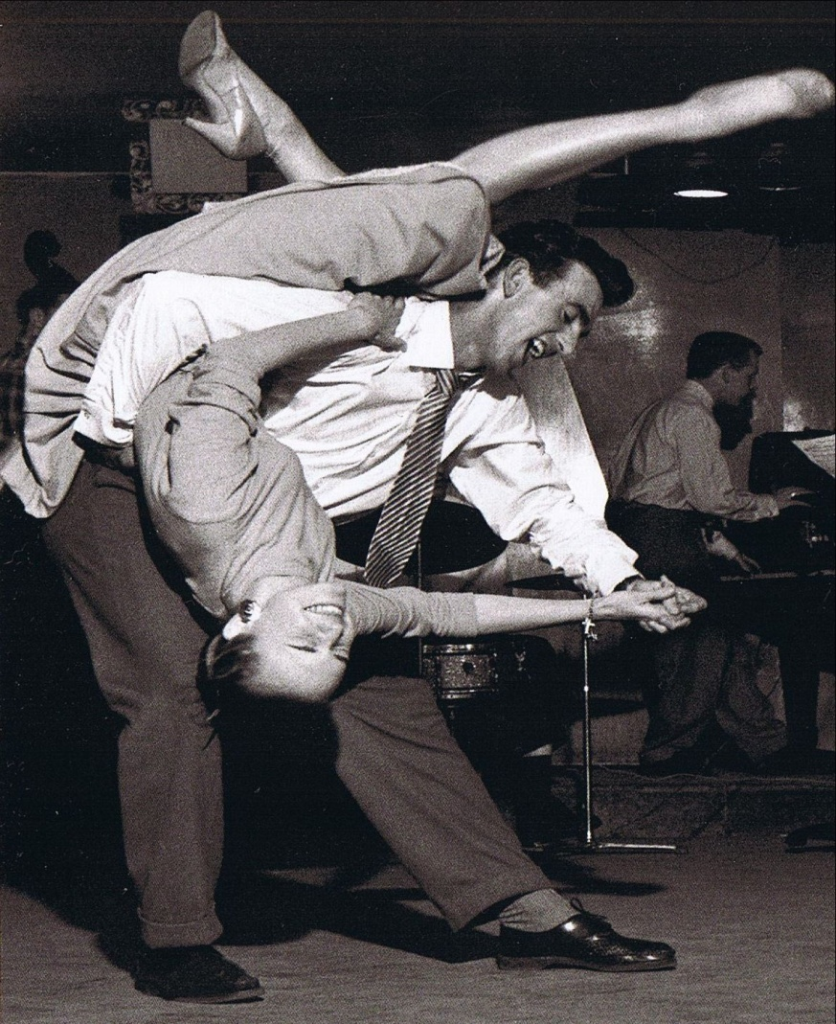
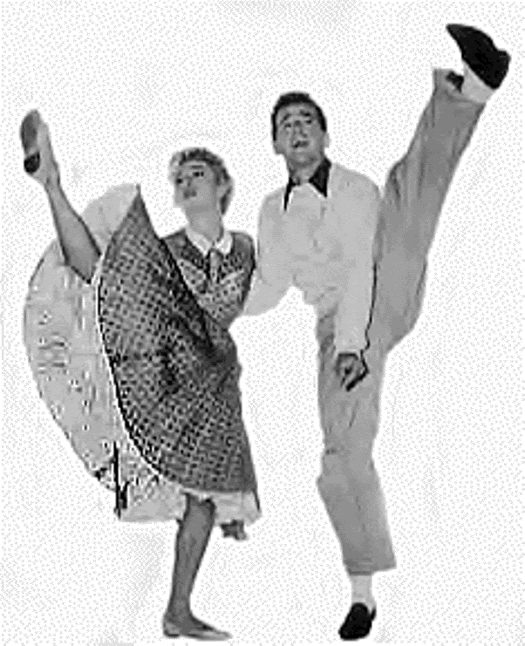
The music was fast and frantically paced and led to dances being banned from dance halls, as the young women being flung into the air by their partners showed their stocking tops and underwear.
Jazz continued to be popular.
6

Slide 7
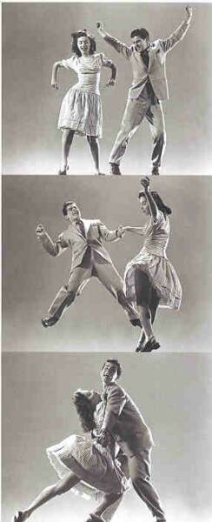
1940s
The Second World War brought fast, frantic (and often American) dance music - boogie-woogie or jitterbug.
Dances were held in church halls, village halls, clubs, Air Force bases - everywhere!
7

Slide 8

After the war 'skiffle' bands became popular.
These bands used household items, such as washboards and tea chests, as part of their set of instruments! Tommy Steele, who later became very famous, first played in a skiffle band.
8

Slide 9

1950s - Rock and Roll became very popular. Since that time, it became one of the best selling music forms. Such bands as Led Zeppelin, the Rolling Stones, Pink Floyd are known around the world
Rock’n’Roll wasn’t just a musical style, it also influenced lifestyles, fashion, attitudes, and language. This new music tried to break boundaries and express the real emotions that people were feeling, but didn't talk about.
9

Slide 10
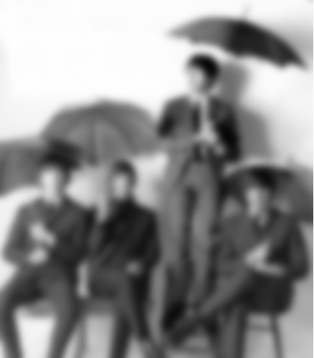
1960s - The Beatles began their career. They leapt to fame in 1963 with 'Please, Please Me'
10

Slide 11

1970s - The first big new sound of the 1970s was “Glam Rock”. In the bleak political backdrop, these British bands and characters brought a welcome relief with their platform boots, sequins, nail varnish and colourful hair.
11

Slide 12
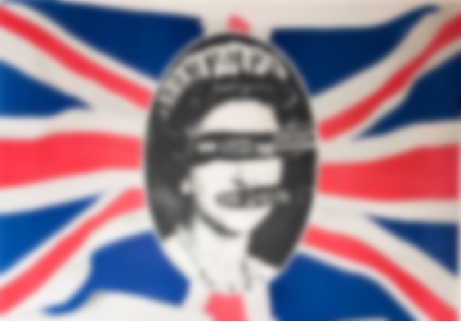
Also at that time Punk movement appeared.
Great British bands of this scene were The Sex Pistols and The Clash.
The Punk style was Mohicans, bondage clothes, safety pins, piercings and bovver boots.
12

Slide 13
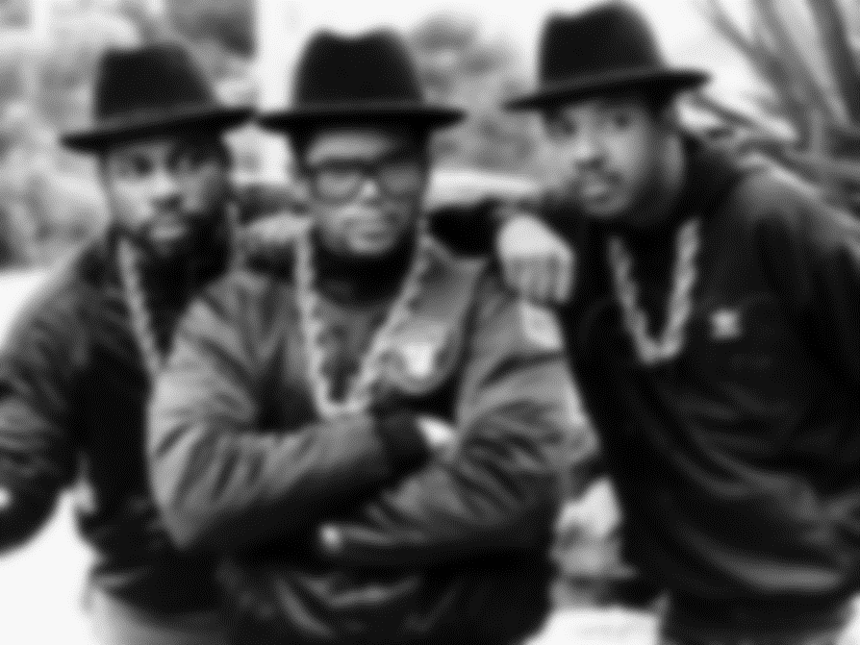
1980s - The 1980s saw the rise of hip hop and rap music, with American influences powerful once again in the form of such groups as Run DMC and Grandmaster Flash and the Furious Five
13

Slide 14

1990s - Britpop
This was the general name given in the 1990s to a new wave of successful British bands who made a big impact in the United States and Europe, as well as in England.
14

Slide 15

At that time also a new music style appeared in Great Britain, which was called trip-hop.
Trip-Hop is the true opposite of the Pop genre.
Its unique sound employs the usage of jazz instruments and melancholy themes mixed with the world of keyboards to create break beat rhythms.
Most popular trip-hop artists are Massive Attack, Morcheeba, Portishead, The Chemical Brothers, Tricky.
15

Slide 16


Music in Britain today
Nowadays young people listen to many different music styles and genres. So the musical life in England is various and diversified.
One of the most popular modern music genres is indie.
Derived from "independent", it describes the small and relatively low-budget labels on which it is released and the do-it-yourself attitude of the bands and artists involved.
Indie rock has been identified as a reaction against the "macho" culture that developed in alternative rock.
16

Slide 17

Оther popular modern music genres are hardcore and post-hardcore
Hardcore punk typically features very fast tempos, loud volume, and heavy bass levels, as well as a "do-it-yourself" ethic.
Post-hardcore includes screaming as the major vocalization technique within most songs, with melodic singing at other times.
17

Slide 18


Enter Shikari combine post-hardcore and heavy metal sub-genres with elements of various electronic genres. They are quite popular not only in GB, but also in the USA and here in Russia.
18

